Slide 1
Analysis of Running Data
Beth Harvey
June 12, 2023

Slide 2
Table of Contents
Background
Goals
EDA
Goal 1 Analysis
Goal 2 Analysis
Conclusions

Slide 3
1. Data Background

Slide 4
1.1 Data Background and Preparation
The original CSV file (activities_all) is exported from my Garmin Connect account and contains the data collected by my Garmin watch.
This includes information like:
> Distance in miles
> Average mile pace
> Minimum/maximum elevation
> Total time
> Average heart rate
Weather data was not included in the CSV file, so it was added manually.
Several default columns for other activities were removed.
Original date range: December 26, 2015 – September 21, 2022
> 2015-2016 were removed due to sparse data
> Activities that were not standard “running” were removed for consistency
> Activities under 2 miles in length were removed, since those are not representative

Slide 5
2. Goals

Slide 6
2.1 Goals of Analysis
Goal 1:
I have felt like my pace has been slower since February or March of 2022, and I wanted to find out if that was accurate. I determined this by using a two-sample t-test to compare my average mile pace for all activities before March 20, 2022 to those after that date.
I also used ANOVA and Tukey’s Range Test to compare my average mile paces from March 20 - September 21 for each year included in the dataset.
I limited the analysis for this goal to runs between 3 and 4 miles in length, since the length of a run could impact my mile pace.
Null Hypothesis: There is no difference in my average mile pace before and after March 20, 2022.
Alternative Hypothesis: There is a difference in my average mile pace before and after March 20, 2022.
Significance Level: 0.05
Goal 2:
I used linear regression to create a model to predict my average mile pace based on features of the run, such as temperature, distance, and elevation.
Null Hypothesis: My average mile pace is not influenced by factors such as run distance, temperature, etc.
Alternative Hypothesis: My average mile pace is influenced by factors such as run distance, temperature, etc.
Significance Level: 0.05

Slide 7
3. Exploratory Data Analysis

Slide 8
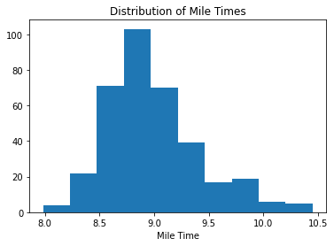
3.1 Mile Pace Distribution
The distribution of my average pace per mile is approximately normally distributed, but slightly right-skewed.

Slide 9
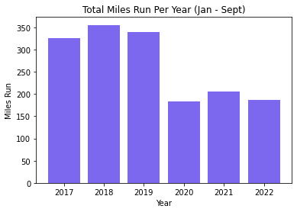
3.2 Total Miles by Year
The total number of miles I ran per year was fairly consistent from 2017-2019 and from 2020-2022. This is most likely because I trained for races in 2017, 2018, and 2019, which leads to me running more.
This data is limited to January - September of each year, because that’s all the data I have for 2022.

Slide 10
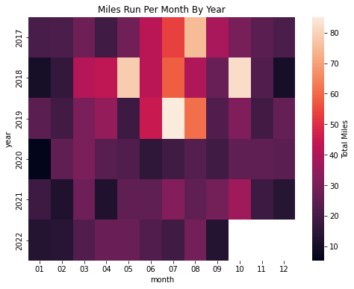
3.3 Miles per Month by Year
The heatmap of miles run per month by year illustrates the training I did for races in 2017-2019. The highest number of miles per month is in the summers of each of those years.
I typically run the least in January and December.

Slide 11
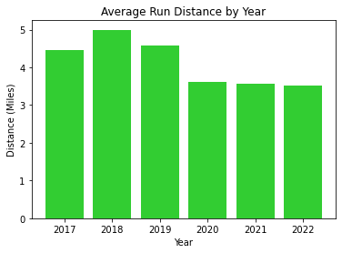
3.4 Average Run Distance by Year
Not only did I run more miles in 2017-2019, but I also ran farther in each individual run on average.
In 2020-2022 I have consistently averaged roughly 3.5 miles per run.

Slide 12
4. Goal 1 Analysis

Slide 13
4.1 Datasets
Limit the data to just the runs with a distance between 3 and 4 miles (activities_3_4).
Divide activities_3_4 into data from before and after March 20, 2022 (activities_after and activities_before for the two-sample t-test.
Divide activities_3_4 into datasets for March 20 - September 21 of each year for the ANOVA and Tukey’s Range Test.
# Get data for runs between 3 and 4 miles in length
activities_3_4 = activities_reg[(activities_reg.distance >= 3) & (activities_reg.distance <= 4)]
# Get data for runs after March 20, 2022)
activities_after = activities_3_4[activities_3_4.date >= '2022-03-20']
# Get data for runs before March 20, 2022 (set 2)
activities_before = activities_3_4[activities_3_4.date < '2022-03-20']
# Get data for March - September for previous years (set 3)
summer_2017 = activities_before[(activities_before.date >= '2017-03-20') & (activities_before.date <= '2017-09-21')]
summer_2018 = activities_before[(activities_before.date >= '2018-03-20') & (activities_before.date <= '2018-09-21')]
summer_2019 = activities_before[(activities_before.date >= '2019-03-20') & (activities_before.date <= '2019-09-21')]
summer_2020 = activities_before[(activities_before.date >= '2020-03-20') & (activities_before.date <= '2020-09-21')]
summer_2021 = activities_before[(activities_before.date >= '2021-03-20') & (activities_before.date <= '2021-09-21')]

Slide 14
4.2 Two-Sample t-test
I used ttest_ind from scipy.stats to run a two-sample t-test comparing my average mile pace before and after March 20, 2022.
Because the ratio of the standard deviations for the two datasets is not close to 1 (1.5), equal_var = False was needed.
The resulting p-value was greater than the significance level of 0.05, so there is not enough evidence to reject the null hypothesis.
tstat, pval = ttest_ind(activities_before.avg_pace_int, activities_after.avg_pace_int, equal_var = False)
print(pval)
Output: 0.9836838069182449

Slide 15
4.3 One-Way ANOVA
I used f_oneway from scipy.stats to compare my average mile pace for March 20 - September 21 of each of the years in the dataset.
The resulting p-value was less than the significance level of 0.05, indicating that at least one of the pairs was significantly different, and a Tukey’s Range Test was needed to determine where the significance was.
fstat, pval = f_oneway(activities_after.avg_pace_int, summer_2017.avg_pace_int, summer_2018.avg_pace_int, summer_2019.avg_pace_int, summer_2020.avg_pace_int, summer_2021.avg_pace_int)
print(pval)
Output: 0.0008007860446498849

Slide 16
4.4 Tukey’s Range Test: Data
In order to easily compare just the March - September data for each year, I created an additional dataset called activities_summer.
This was used for the Tukey’s Range Test to determine which pair(s) had significant differences.
# Create dataset of all runs between March 20 and September 21 for each year
activities_summer = activities_reg[
((activities_reg.date >= '2017-03-20') & (activities_reg.date <= '2017-09-21')) | ((activities_reg.date >= '2018-03-20') & (activities_reg.date <= '2018-09-21')) | ((activities_reg.date >= '2019-03-20') & (activities_reg.date <= '2019-09-21')) | ((activities_reg.date >= '2020-03-20') & (activities_reg.date <= '2020-09-21')) | ((activities_reg.date >= '2021-03-20') & (activities_reg.date <= '2021-09-21')) | ((activities_reg.date >= '2022-03-20') & (activities_reg.date <= '2022-09-21'))]

Slide 17
4.5 Tukey’s Range Test: Results
I used pairwise_tukeyhsd from statsmodels.stats.multicomp to determine which pairs of years were significantly different.
The only year that was significantly different from the others was 2021. Therefore, the null hypothesis can be rejected for that year, but none of the others.
tukey_results = pairwise_tukeyhsd(activities_summer.avg_pace_int, activities_summer.year, 0.05)
print(tukey_results)
Output:
Multiple Comparison of Means - Tukey HSD, FWER=0.05
====================================================
group1 group2 meandiff p-adj lower upper reject
----------------------------------------------------
2017 2018 -0.0899 0.9659 -0.4105 0.2306 False
2017 2019 -0.0048 1.0 -0.38 0.3705 False
2017 2020 0.1528 0.7854 -0.1857 0.4912 False
2017 2021 0.3492 0.0338 0.0162 0.6821 True
2017 2022 -0.0138 1.0 -0.3456 0.3179 False
2018 2019 0.0852 0.9623 -0.2114 0.3817 False
2018 2020 0.2427 0.0597 -0.0057 0.4911 False
2018 2021 0.4391 0.0 0.1982 0.68 True
2018 2022 0.0761 0.9422 -0.1631 0.3153 False
2019 2020 0.1575 0.7054 -0.1582 0.4733 False
2019 2021 0.3539 0.015 0.044 0.6638 True
2019 2022 -0.0091 1.0 -0.3177 0.2996 False
2020 2021 0.1964 0.2718 -0.0678 0.4606 False
2020 2022 -0.1666 0.4521 -0.4293 0.0961 False
2021 2022 -0.363 0.0009 -0.6186 -0.1074 True
----------------------------------------------------

Slide 18
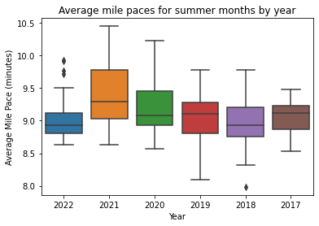
4.6 Visual Comparison of ANOVA Data
A side-by-side boxplot of my mile pace data by year confirms the results from the ANOVA and Tukey tests.
The averages for all years except 2021 are fairly consistent.
The average for 2021 is higher than the rest.
Contrary to my hypothesis, my average mile pace in 2022 is actually one of the lowest, despite a few outliers on the higher end.

Slide 19
5. Analysis of Goal 2

Slide 20
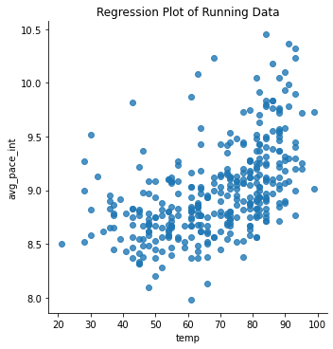
5.1 Check for Linearity
A scatter plot of my average mile pace vs the temperature during the run showed the highest visual correlation.
There appeared to be a curvilinear relationship between the two variables.

Slide 21
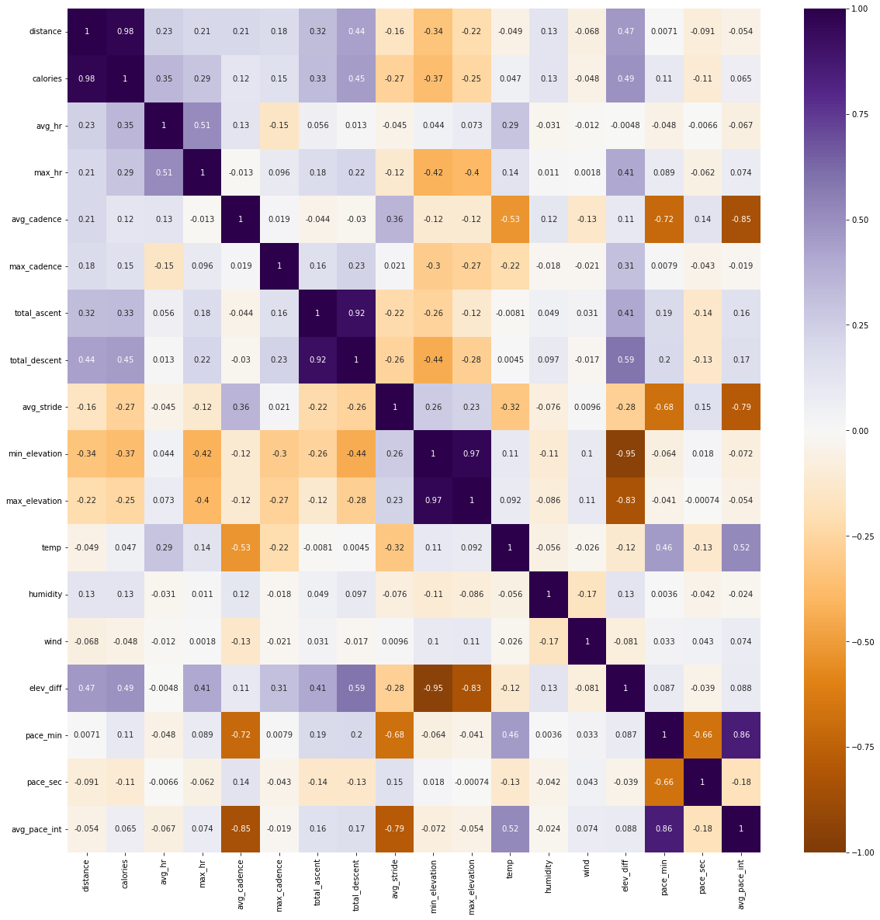
5.2 Check for Multicollinearity
Next I used a heatmap to check for multicollinearity between different parameters.
It is difficult to see here, but a larger version is available in the Jupyter file.
Most collinear variables were expected, such as total_ascent/total_descent or distance/calories

Slide 22
5.3 Linear Regression Model
I tried several combinations of predicting variables for the linear regression model. None of them yielded as strong of results as I was hoping, but the best model I found used the temperature, the square of the temperature, and the total elevation change.
The p-value indicates that these factors do influence my average mile pace.
model_temp_elev = sm.OLS.from_formula('avg_pace_int ~ temp + np.power(temp, 2) + elev_diff', data = activities_reg).fit()
print(model_temp_elev.summary())
OLS Regression Results
==============================================================================
Dep. Variable: avg_pace_int R-squared: 0.360
Model: OLS Adj. R-squared: 0.355
Method: Least Squares F-statistic: 66.09
Date: Mon, 10 Oct 2022 Prob (F-statistic): 6.43e-34
Time: 20:16:13 Log-Likelihood: -119.37
No. Observations: 356 AIC: 246.7
Df Residuals: 352 BIC: 262.2
Df Model: 3
Covariance Type: nonrobust
=====================================================================================
coef std err t P>|t| [0.025 0.975]
-------------------------------------------------------------------------------------
Intercept 9.2413 0.260 35.593 0.000 8.731 9.752
temp -0.0356 0.008 -4.396 0.000 -0.051 -0.020
np.power(temp, 2) 0.0004 6.21e-05 6.141 0.000 0.000 0.001
elev_diff 0.0024 0.001 4.026 0.000 0.001 0.004
==============================================================================
Omnibus: 50.808 Durbin-Watson: 1.327
Prob(Omnibus): 0.000 Jarque-Bera (JB): 78.164
Skew: 0.888 Prob(JB): 1.06e-17
Kurtosis: 4.455 Cond. No. 7.79e+04
==============================================================================

Slide 23
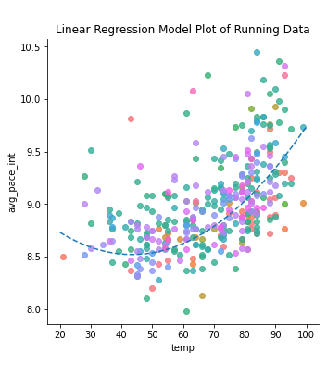
5.4 Plot Model Regression Line
The regression line from this model follows the curvilinear trend of the data.
It looks like I run fastest when the temperature is between 45 and 60 degrees.
This plot adds the elevation difference as the hue, but the legend for that was too big to fit here. The full version is available in the Jupyter file.
x = np.linspace(20, 100, 100)
y = model_temp_elev.params[0] + model_temp_elev.params[1]*x + model_temp_elev.params[2]*np.power(x, 2) + model_temp_elev.params[3]*x
sns.lmplot(x = 'temp', y = 'avg_pace_int', hue = 'elev_diff', fit_reg = False, data = activities_reg)
plt.title('Linear Regression Model Plot of Running Data')
plt.plot(x, y, linestyle = 'dashed')
plt.show()
plt.clf()

Slide 24
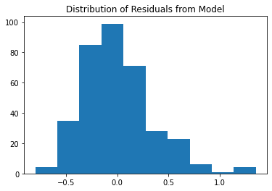
5.5 Calculate and Check Distribution of Residuals
The residuals are slightly right-skewed, meaning the model is slightly more likely to predict an average mile pace that is lower than the true value.
# Calculate fitted values and residuals
fitted_values = model_temp_elev.predict(activities_reg)
residuals = activities_reg.avg_pace_int - fitted_values
# Check normality assumption
plt.hist(residuals)
plt.title('Distribution of Residuals from Model')
plt.show()
plt.clf()

Slide 25
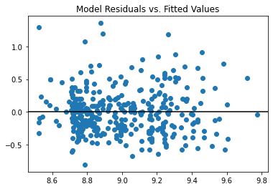
5.6 Check Homoscedasticity Assumption
The residuals look evenly distributed across the fitted values, confirming the homoscedasticity assumption.
# Check homoscedasticity assumption
plt.scatter(fitted_values, residuals)
plt.axhline(y=0, color='black', linestyle='-')
plt.title('Model Residuals vs. Fitted Values')
plt.show()
plt.clf()

Slide 26
6. Conclusions

Slide 27
6.1 Conclusions: Goal 1
There is not enough evidence to reject the null hypothesis. The p-value of the two-sample t-test between data from before and after March 20, 2022 is 0.98, much higher than the significance threshold of 0.05, indicating that there is not a significant difference between the two data sets.
The one-way ANOVA showed that the data from at least one year was significantly different than the others, but that year was 2021, not 2022. This is further illustrated by the side-by-side boxplots of the data.
My average mile pace for regular 3-4 mile runs has remained roughly consistent over the past 6 years.

Slide 28
6.2 Conclusions: Goal 2
The best model I was able to make used the temperature, the square of the temperature, and the total elevation change to predict my average mile pace. Surprisingly, the distance of the run did not have a large impact on the average mile pace. This could be because I am more likely to run longer distances when I am training for a race, and therefore in better shape.
I am not very satisfied with this model, since the R-squared value is only 0.360, meaning that only 36.0% of the variation in pace can be explained by these predictors. I would like to revisit this data after I learn more about machine learning and make a new model.

Slide 29
6.3 Other Observations
The distribution of my mile paces is normal, but slightly right-skewed (skewed towards slower times).
My total run distance by year (Jan-Sept) was pretty consistent for 2017-2019, then dropped to a lower, but still consistent level for 2020-2022. This makes sense, because I was using training schedules in 2017-2019, which leads me to run farther. This is also demonstrated in the heatmap of miles per month, where I ran more miles in the summers of those years than any other times in this dataset.
I typically run fastest in the temperature range of 45-65 degrees.
The full code can be found on my Github account: https://github.com/bethharvey

